Slide 1

Go, change the world
RV College of
Engineering
Students Attendance Monitoring System Using Convolutional Neural Network
Minor Project : 18MDC24
Sumana E N (1RV19LDC29)
Yeshwanth R (1RV19LDC33)
Program : DCE
Guide Name: Viswavardhan Reddy K
Designation: Assistant Professor
13/04/2020
Department of TCE
1

Slide 2

Go, change the world
TABLE OF CONTENTS
RV College of
Engineering
Introduction
Literature Survey
Motivation
Problem Definition
Objectives
Convoutional Neural Networks
Haar Cascade Algorithm
Methodology
Implementation
Results
Conclusion
References

Slide 3
Go, change the world
RV College of
Engineering
Introduction
What is Attendance Monitoring system(AMS)?
Takes attendance of students in each class.
Can be manual or automatic.
2. How is our Attendance Monitoring System different from existing system?
Existing System is a Manual system where there is use of registers.
Time Consuming.
Burden on the staff.
The proposed framework overcomes the drawbacks of the existing system.
There will be no interruptions or wasting of time just to take attendance of students
3. What do we tend to Achieve by using AMS?
Automated attendance monitoring of students hassle free.
Department of TCE
3

Slide 4
Go, change the world
RV College of
Engineering
Literature Review
Sl.no | Paper title | Year | Abstract /understanding
1 | Face Recognition using Depth Images Base Convolutional Neural Network | 2019 | Face recognition based on depth images is widely studied due to its advantages of 3-dimensional information and environment illumination insensitivity.To achieve a better face recognition performance on depth images, this paper proposes a method based on Convolutional Neural Networks (CNN).
2 | An Improved Version of Student Attendance Management System Based on RFID | 2019 | In Most of the AMS they use - Radio Frequency Identification (RFID) technology, biometric solutions such as fingerprint and face recognition and mobile devices – mostly smartphones. In this paper an improved version of the system based on RFID and some results of its use in a real environment is shared. The are some improvements to a hardware component RFID reader and to a web based application that is used by the faculty staff. the system also includes features that enable integration with external systems, recording of necessary data of teachers in class and generating periodical reports on their work
3 | RFID-Based Students Attendance Management System | 2013 | RFID technology facilitates automatic wireless identification using electronic passive and active tags with suitable readers. In this paper, an attempt is made to solve recurrent lecture attendance monitoring problems in developing countries using RFID technology
Department of TCE
4

Slide 5
Go, change the world
RV College of
Engineering
Literature Review continued..
Sl.no | Paper title | Year | Abstract/ understanding
4 | What is the challenge for Deep Learning in Unconstrained Face Recognition? | 2018 | Deep learning has become dominant in face recognition and many other artificial intelligence areas.using the state-of-the-art deep networks. Some interesting results are obtained, and studies can show directions to promote the deep learning methods towards high-accuracy and practical use in solving the hard problem of unconstrained face recognition.
5 | Multi-Faces Recognition Process Using Haar Cascades and Eigenface Methods | 2018 | This paper proposes solutions for a faster face recognition process with accurate results. The proposed face recognition process is done using a hybrid process of Haar Cascades and Eigenface methods, which can detect multiple faces in a single detection process recognize multiple faces with good accuracy level.
6 | Approaches on Partial Face Recognition: A Literature Review | 2019 | This paper provides an overview of different partial face recognition approaches proposed. Image processing has a research area in the scope of image analysis, computer vision and pattern recognition. Face recognition is an area which has attained attention over the last few decades. The traditional applications of face recognition system, especially those used for access control, authentication,and surveillance, usually need maximum information of face to attain exceptional performance in recognition. Occasionally it is difficult to get access of a full face under certain restricted situations.
Department of TCE
5

Slide 6
Go, change the world
RV College of
Engineering
Literature Review continued..
Sl.no | Paper title | Year | Abstract understanding
7 | Smart Attendance Monitoring System (SAMS): A Face Recognition based Attendance System for Classroom Environment | 2018 | In present academic system, regular class attendance of students’ plays a significant role in performance assessment and quality monitoring. The conventional methods practised in most of the institutions are by calling names or signing on papers, which is highly time-consuming and insecure. This article presents the automatic AMS for convenience or data reliability. The system is developed by the integration of ubiquitous components to make a portable device for managing the students’ attendance using Face Recognition technology.
8 | Joint Bayesian Face Recognition Based on Data Adaptive Enhancement and Feature Fusion | 2018 | In the face recognition, training data is sometimes limited, and even a single face photo per person,which causes the model less trained to recognize the multi-pose facial image with low recognition rate. In this paper, aiming at the face recognition using small sample training set, a joint Bayesian face recognition algorithm based on adaptive face data enhancement combined with global and local feature fusion is proposed. The experiment result shows that the proposed algorithm makes the multi-gesture face recognition performance well.
9 | Performance Analysis of Human Face Recognition Techniques | 2019 | Face recognition has been thought-provoking task in object detection, digital image processing and pattern recognition.Face recognition plays a significant role in real-time surveillance systems. In this paper, we present a comprehensive overview of the state of the art research work on face detection and recognition. Furthermore,the performance analysis of various face recognition approaches are discussed and conclude the paper with future research direction.
Department of TCE
6

Slide 7
Go, change the world
RV College of
Engineering
Motivation
The present system is Register book.
The maintenance of these records for a longer time is considerably tedious and requires more efforts from the staff.
How to overcome these drawbacks?
Pre-requisites.
Advantages.
Department of TCE
7

Slide 8
Go, change the world
RV College of
Engineering
Objectives
To understand the basics of programming language Python, working with database - MS Excel and also understanding existing attendance monitoring systems.
To propose a framework of Automated Attendance Monitoring System(AMS)
To collect data samples by deploying cameras in the classroom.(With-held due to COVID-19)
To develop a machine learning algorithm, which helps in correctly identifying the student's face and mark the attendance with the linked excel sheet or in a database.
Department of TCE
8

Slide 9
Go, change the world
RV College of
Engineering
Problem Definition
Developing a framework for monitoring the student’s attendance using ML algorithm
The framework aims at
Reducing the paperwork
Saving time and resources
Maintaining the records for a longer or specified time.
for the teaching staff to generate accurate student’s attendance.
Department of TCE
9

Slide 10
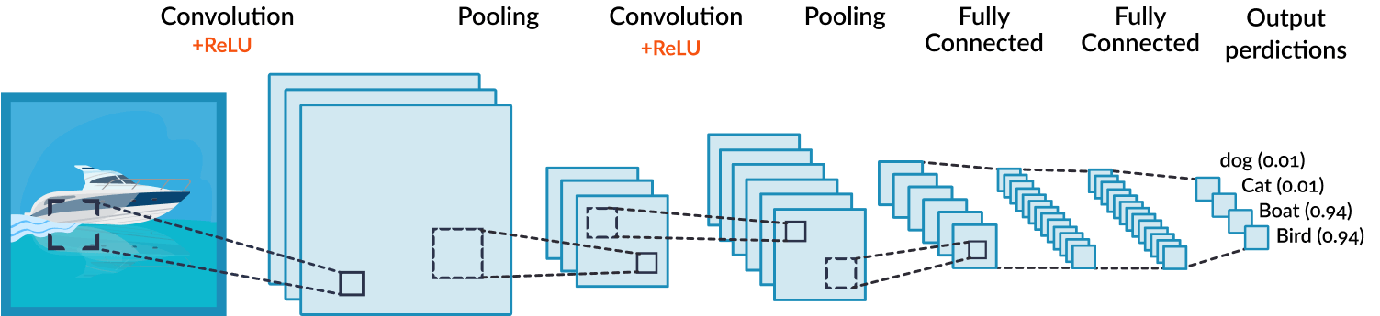
Go, change the world
RV College of
Engineering
CONVOLUTIONAL NEURAL NETWORK
A Convolutional Neural Network (ConvNet/CNN) is a Deep Learning algorithm which can take in an input image, assign importance to various aspects/objects in the image and be able to differentiate one from the other.
The pre-processing required in a ConvNet is much lower as compared to other classification algorithms.
With enough training, ConvNets have the ability to learn these filters/characteristics.
The architecture performs a better fitting to the image dataset.
The role of the ConvNet is to reduce the images into a form which is easier to process, without losing features which are critical for getting a good prediction.

Slide 11

Go, change the world
RV College of
Engineering
CONVOLUTIONAL NEURAL NETWORK
FILTERING & NORMALIZATION: CONVOLUTION + RELU
FILTERING:
Line up a feature and the image patch.
Multiply each image pixel by the corresponding feature pixel.
Add them up.
Divide by the total number of pixels in a image.
NORMALIZATION:
Change the negative values to 0.
Kernel/Filter,
K = 1 0 1 0 1 0 1 0 1

Slide 12



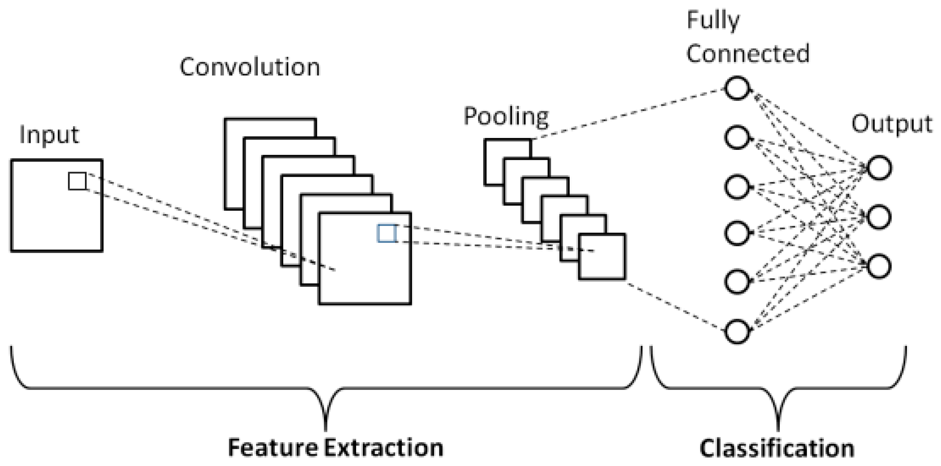
Go, change the world
RV College of
Engineering
CONVOLUTIONAL NEURAL NETWORK
POOLING: RESIZING
Shrinking the image stack.
Pick a window size.
Pick a stride.
Walk the window across the filtered image.
From each window, take the maximum value.
FULLY CONNECTED LAYER
Every value gets a vote.
A list of feature values becomes list of votes.
Errors are adjusted based on gradient descent approach.

Slide 13
Go, change the world
HAAR CASCADE CLASSIFIER
RV College of
Engineering
Haar-Cascading algorithm is a Machine Learning Classification algorithm.
In this algorithm, the cascade function is trained using many positive and negative samples.
The Haar Cascade Classifier is trained in four stages.
Haar Feature Selection: This feature detects and considers the adjacent rectangular regions in the given image segment, and it adds to the pixel intensities in each image and calculates the difference between the two sums.
Integral Images: Integral Images boost the speed of the classifier. It makes the computations super-fast.
Boosting Algorithm: This algorithm is used to select best features out of many features and to train the classifiers depending on the performance. We mainly use Adaboost algorithm at this stage.
Cascade Classifier: These classifiers are collections of many stages. Each stage represents a weak classifier commonly referred to as decision stumps. These decision stumps are trained by using Boosting Technique, which has the ability to train a highly accurate classifier which uses a weighted average of the decision made by the decision stumps.
Department of TCE
13

Slide 14
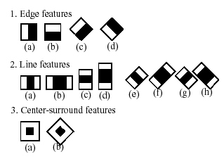
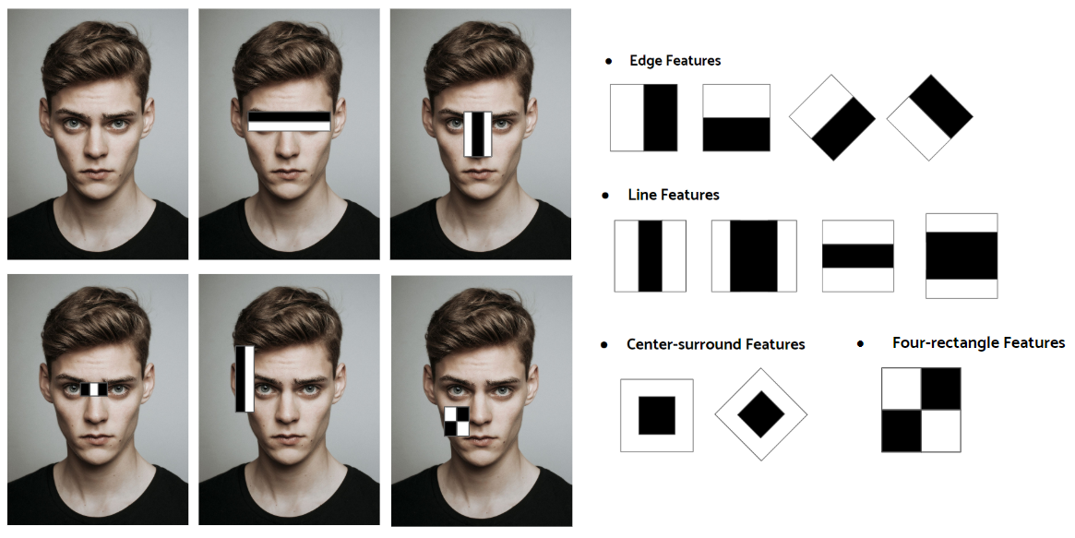
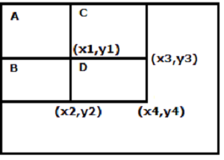
Go, change the world
RV College of
Engineering
WORKING OF THE CLASSIFIER
1. Haar-Feature Selection
F(haar)=F(white)-F(black)
Where, ∑f(white) is the number of pixels in white region, ∑f(black) is the number of pixels in black, F(haar) is haar feature.
2. Integral Images
Sum=(D+A)-(B+C)
Sum=(x4,y4)+(x1,y1)-((x3,y3)+(x2,y2))
Department of TCE
14

Slide 15
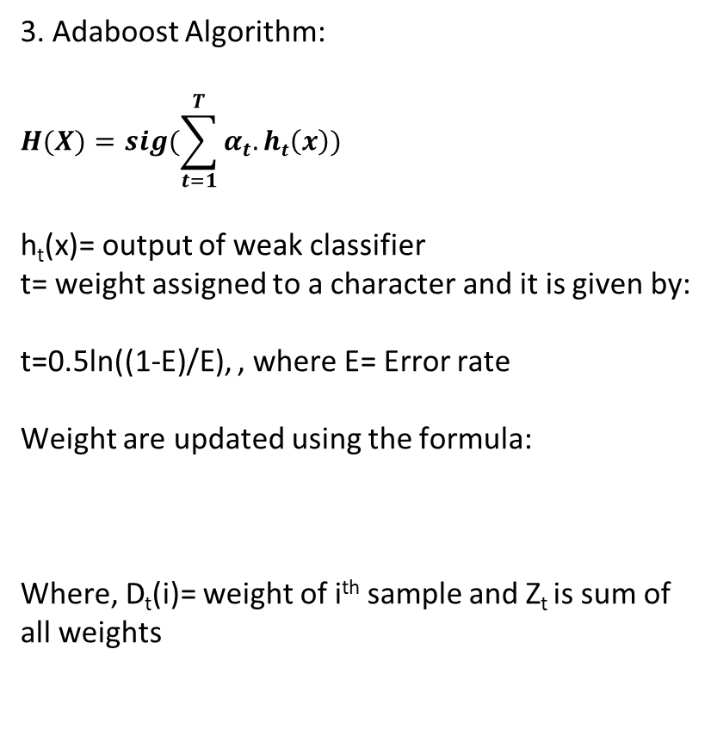
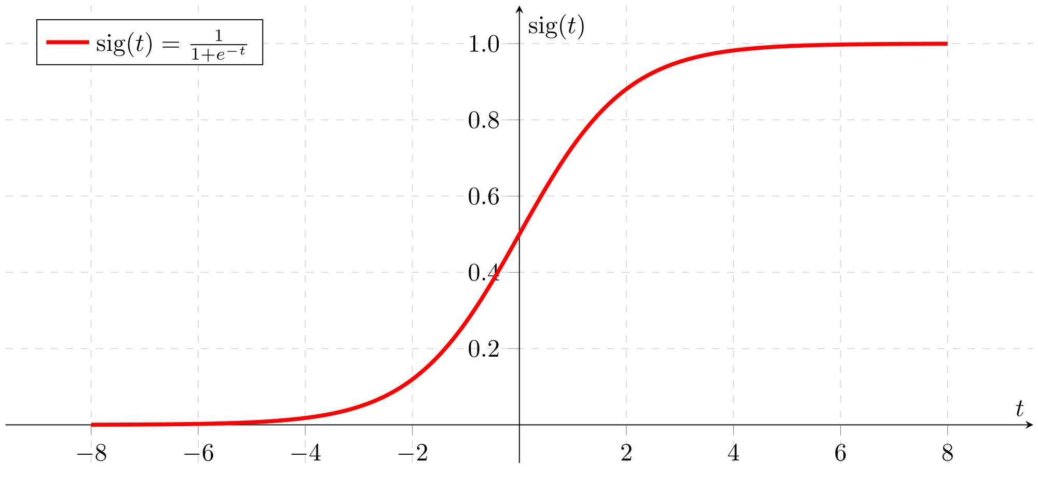

Go, change the world
RV College of
Engineering
WORKING OF THE CLASSIFIER
4. Cascade Classifier
The stages of the classifier are given by current locations of the sliding window.
The stages may be positive or negative. When an object is detected, the region is considered to be positive and when there is no object detected, the region is considered to be negative.
When the final region is detected as positive, the detector reports the object as found. There are some cases where a classifier might give an error with respect to classification.
Condition | Outcome
Positive | Object detected and recognised
Negative | Object not detected and not recognised
False Positive | Object not detected but recognised
False Negative | Object detected but not recognised
Department of TCE
15

Slide 16
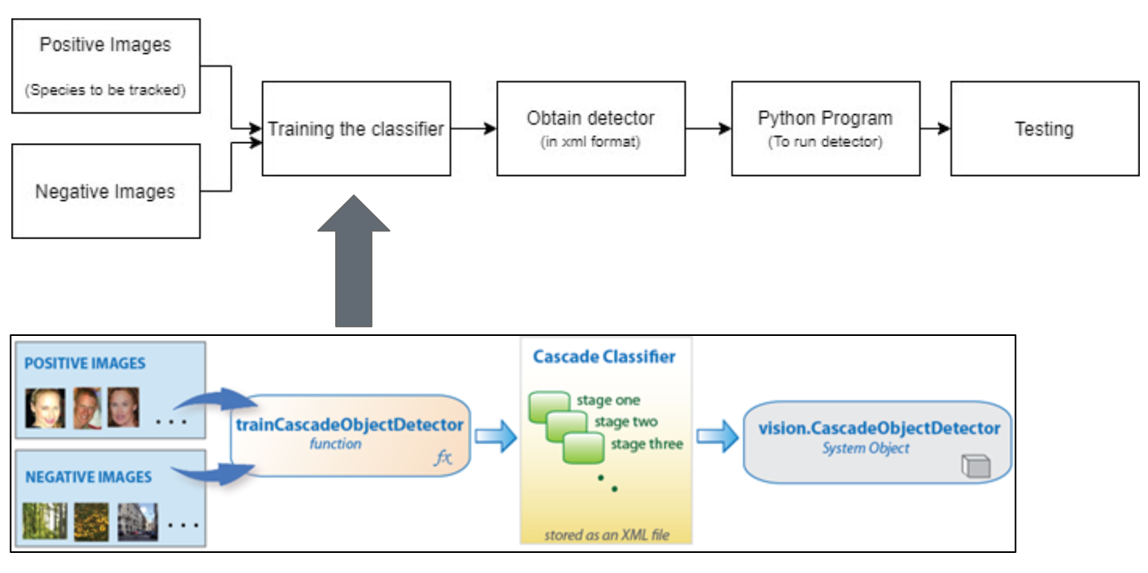
Go, change the world
RV College of
Engineering
CASCADE CLASSIFIER SUMMED UP
Department of TCE
16

Slide 17
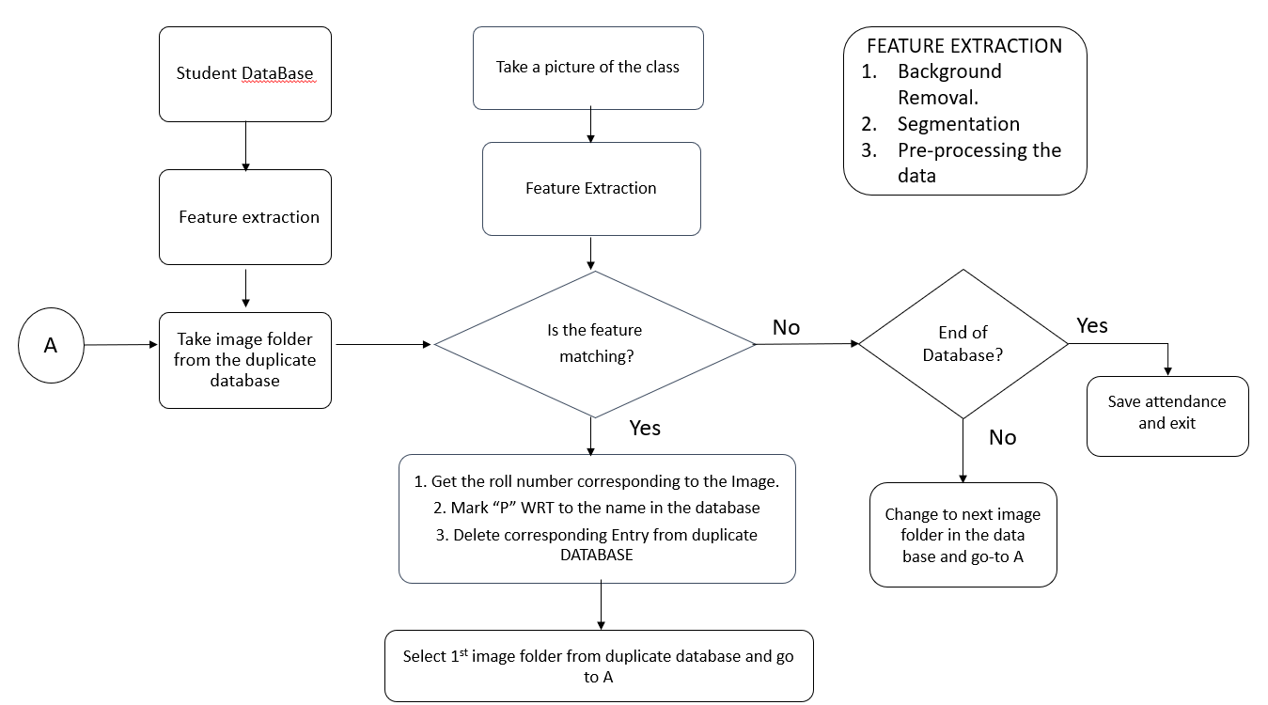
Go, change the world
RV College of
Engineering
Methodology
Department of TCE
17

Slide 18
Go, change the world
RV College of
Engineering
IMPLEMENTATION
DATABASE
Code takes a picture of the user standing in front of the webcam.
Approximately 30 – 50 pictures of each user is collected for training the classifier.
TRAINING
The images taken are preprocessed
Feature extraction is done by the CNN
The classifier - Haar cascade Classifier is then trained using the above samples.
RECOGNITION
Real time snap of the user is taken by the code using the webcam.
The input is compared by the classifier
The confidence level for the image is checked.
Required action is taken.

Slide 19

Go, change the world
RESULTS AND SIMULATIONS
RV College of
Engineering
The collection of samples must be done
In adequate lighting.
Only one face should be detected for sample collection.
Total number of entries must be known.
2. While recognition
the distance between camera and people should be min of 2 ft.
The posture of the person should be straight.

Slide 20
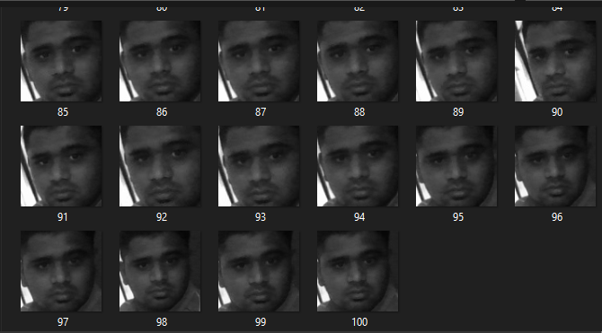

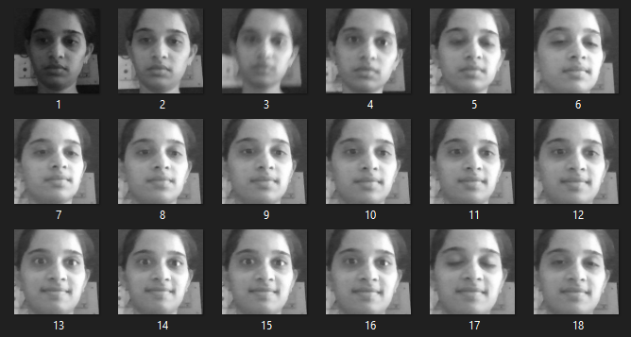
Go, change the world
RV College of
Engineering
OUTPUTS of Data Collection
Department of TCE
20

Slide 21
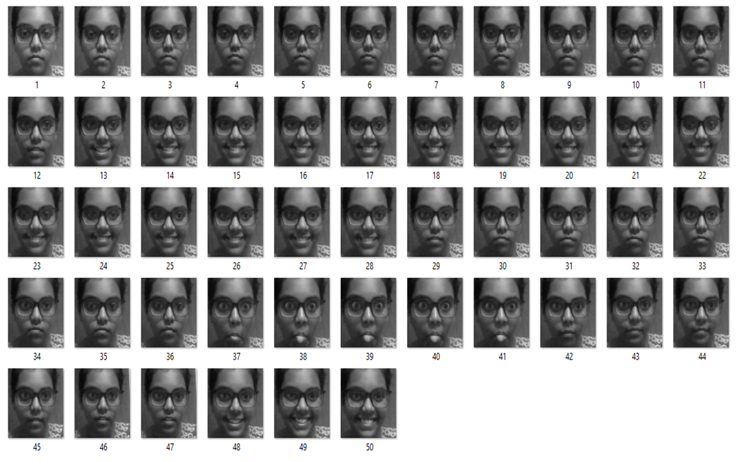
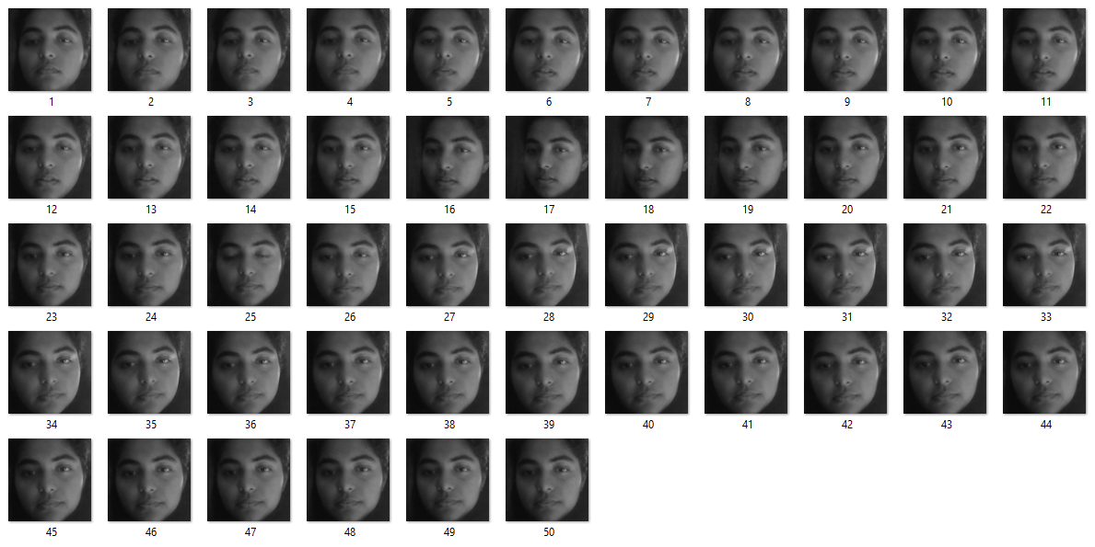
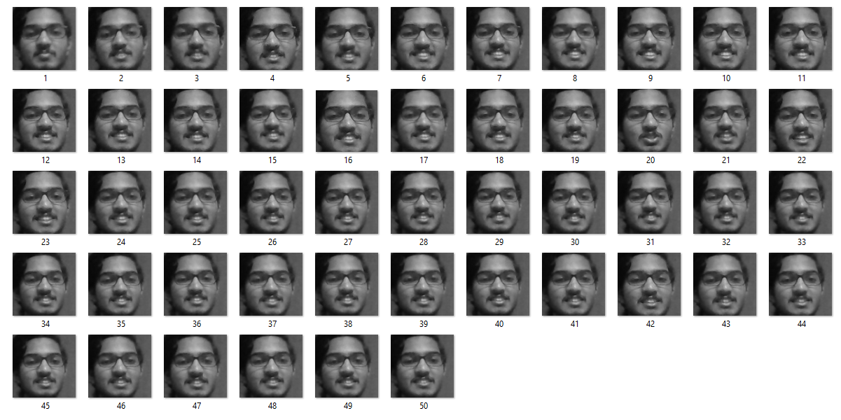
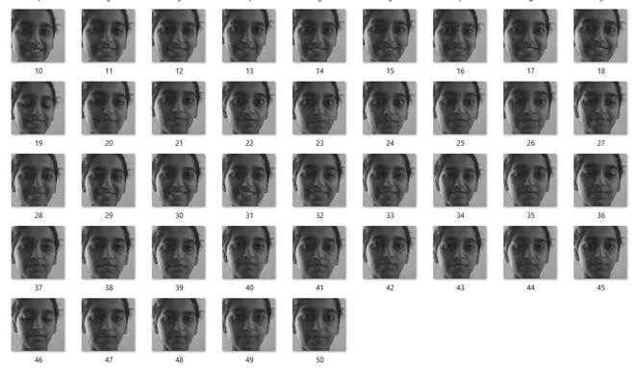
Go, change the world
RV College of
Engineering
1
R
V
1
9
L
D
C
0
2
1
R
V
1
9
L
D
C
0
3
1
R
V
1
9
L
D
C
1
8
1
R
V
1
9
L
D
C
2
6

Slide 22
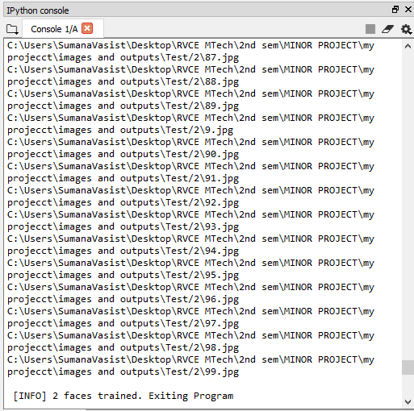
Go, change the world
RV College of
Engineering
OUTPUTS of Face Training
Department of TCE
22

Slide 23
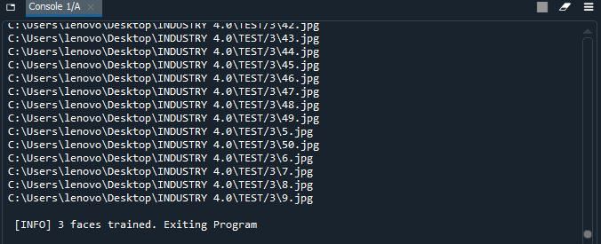
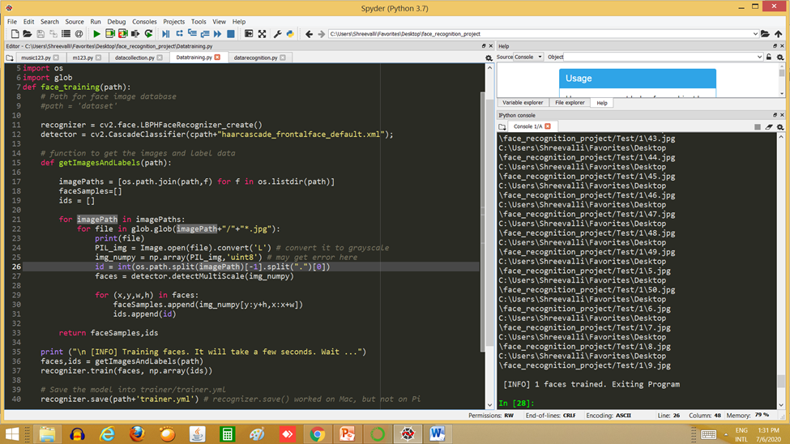
Go, change the world
RV College of
Engineering
The collected samples are trained using Haar-Cascade classifier.
The weights of the training algorithm is stored in a file – trainer.yml in a given path

Slide 24
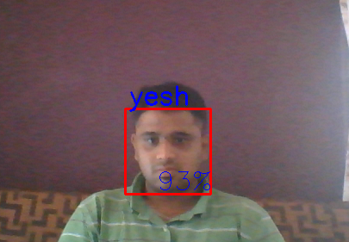
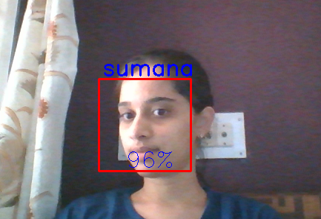
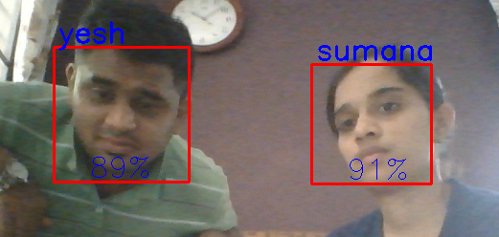
Go, change the world
RV College of
Engineering
Outputs And Results Of Recogniton
Department of TCE
24

Slide 25
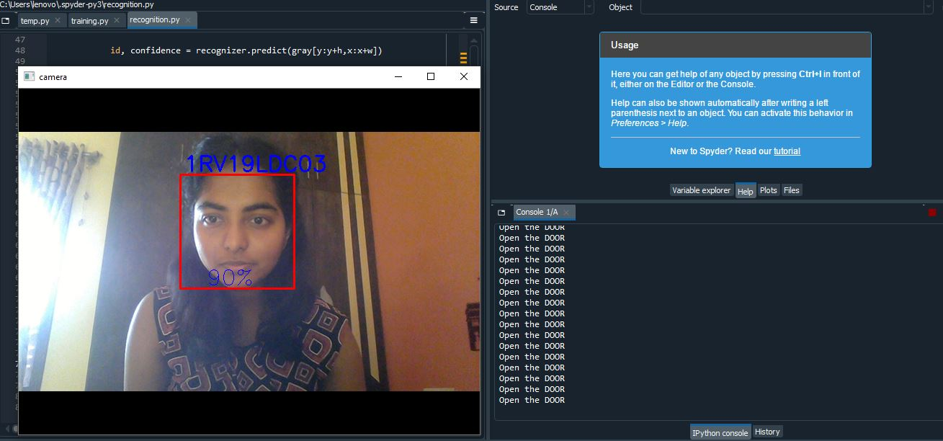
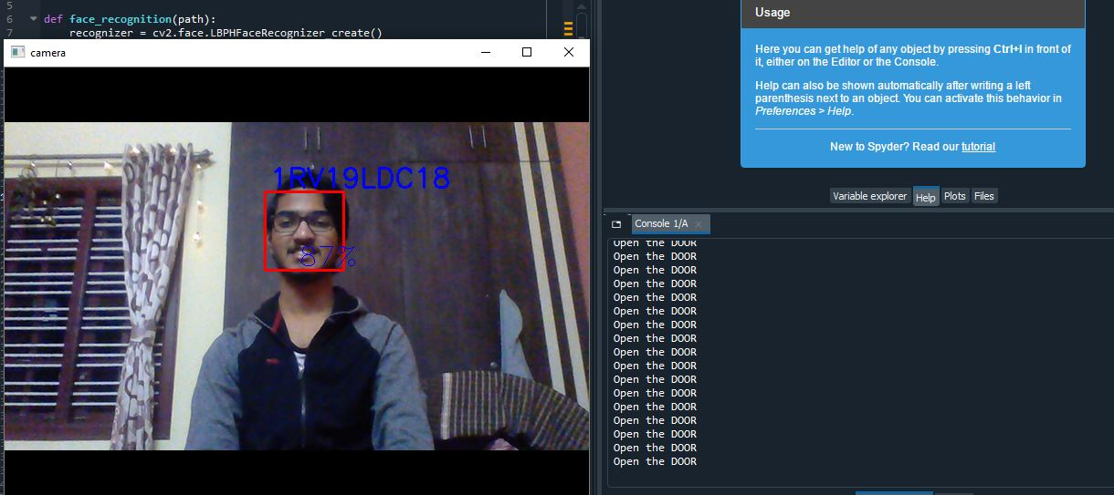
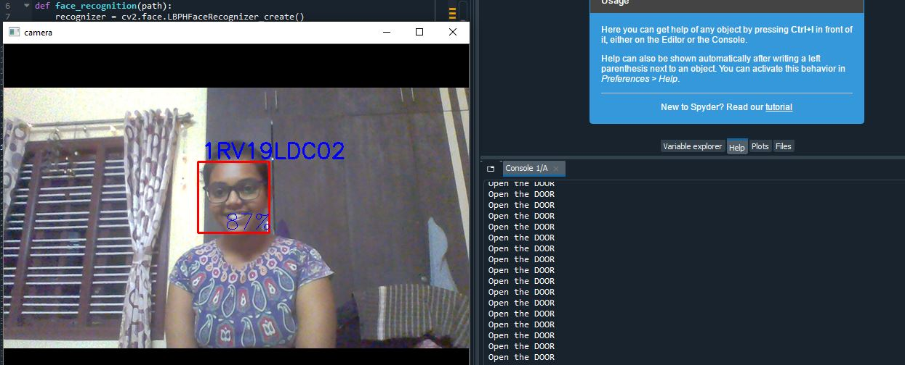
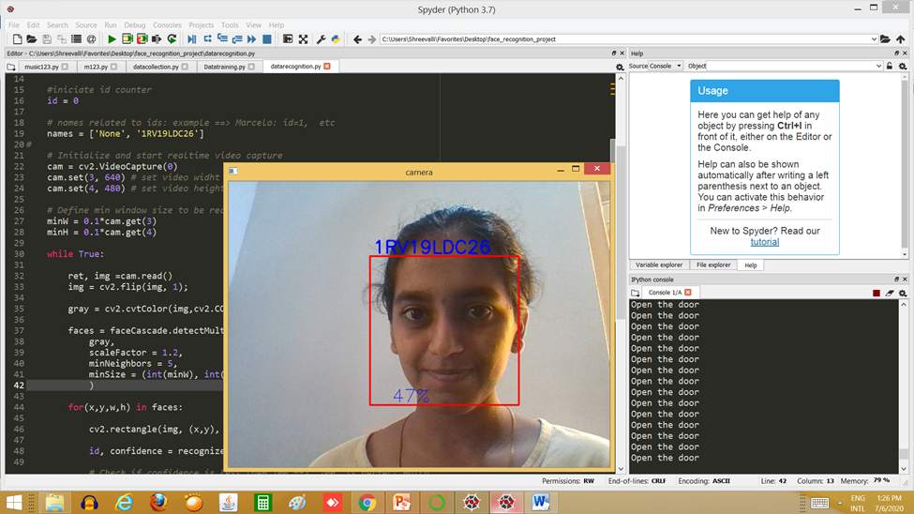
Go, change the world
RV College of
Engineering

Slide 26
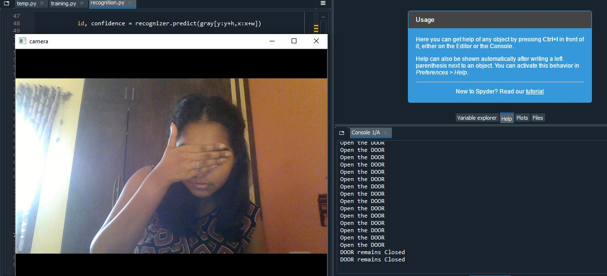
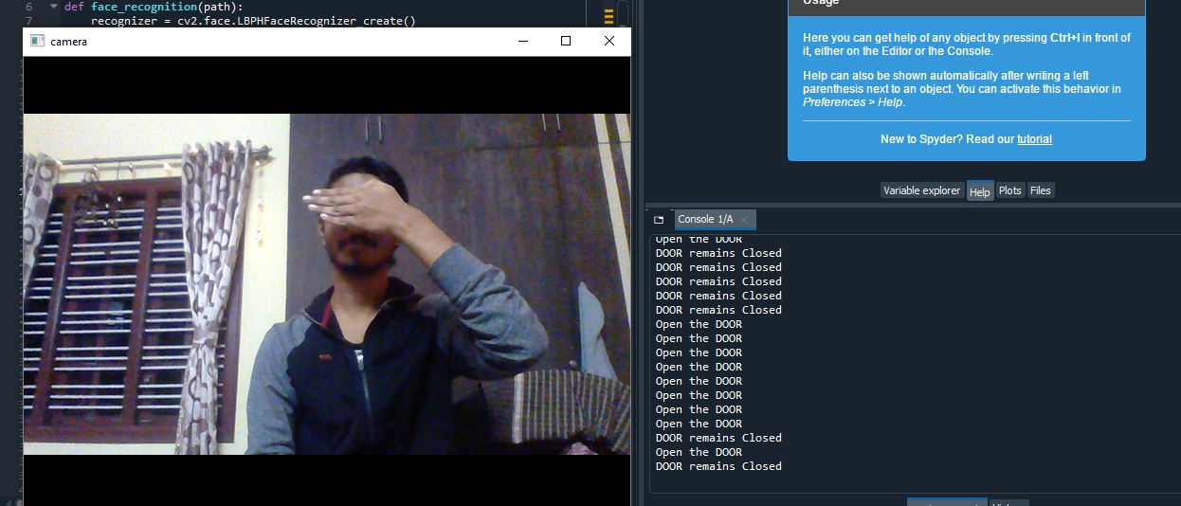
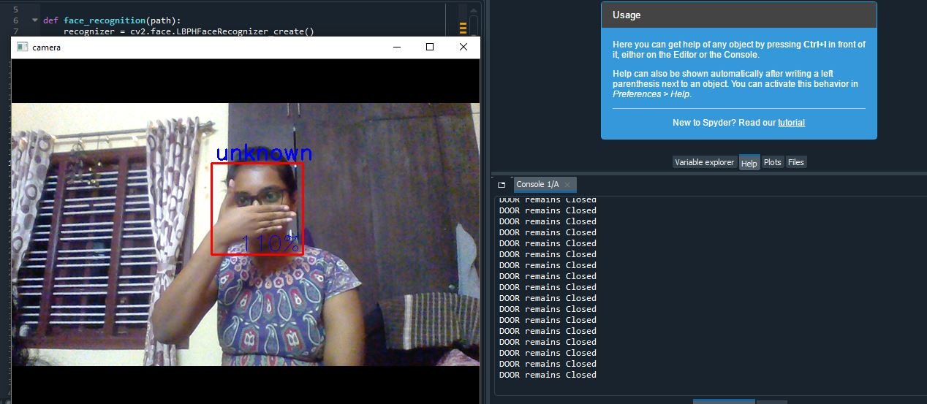
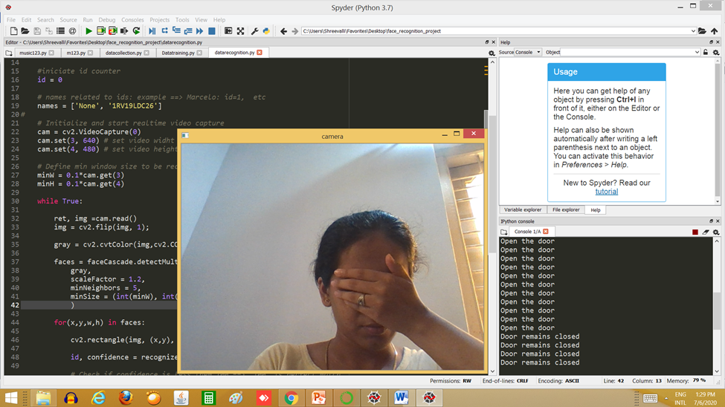
Go, change the world
RV College of
Engineering

Slide 27
Go, change the world
RV College of
Engineering
Attendance Updating using Excel

Slide 28
Go, change the world
UNDERSTANDING
RV College of
Engineering
Confidence of the Classifier
The correctness of the detection and recognition of a face in an image
The confidence of detection in our algorithm is in between 84% and 95% depending on lighting, training and the matching of prerequisites.
Accuracy of The classifier
Number of times the recognition is done correctly over total number of attempts made.
The accuracy of the system is 95%.

Slide 29
Go, change the world
RV College of
Engineering
CONCLUSION
Sample of individual person is collected using a camera/WEBCAM.
A sample of 50 images of a person is captured using the webcam of the laptop. The samples collected are of different expressions.
The collected samples are grouped with respect to Face_id (USN).
The samples corresponding to a particular Face_id is stored in a folder “Test”. These samples are gray-scale images and are only the face of the person as shown. These samples are used to train the classifier.
The classifier is trained with respect to USN using CNN & Haar- Cascade classifier.
TESTING:
A new photo is captured from the camera and is given to recognizer.
The recognizer recognizes the face in the new image and maps it to corresponding USN.
If USN is authenticated, ATTENDANCE IS MARKED if not it remains absent as a default.

Slide 30
Go, change the world
FUTURE WORK
RV College of
Engineering
Face recognition in a critical environment.
Recognition using different algorithms can be studied.
New features which can be used to manipulate the attendance like calculation the percentage of attendance of students and providing the eligibility can be included
Battery Powered System can be made.
Hardware Implementation: The basic action of the Hardware is to work hand in hand with the proposed Software such that we get to implement the proposed system. Hardware components used are: Camera, Storage, Processing unit (Computer)

Slide 31
Go, change the world
RV College of
Engineering
References
[1]. Juxiang Chen et.al, “ Face Recognition using depth image based convolutional neural network”, in the proceedings of International Conference on Computer, Information and Telecommunication Systems (CITS 2019), 978-1-7281-1374-6/19/$31.00, 2019
[2]. Guodong Guo, Na Zhang, “ What is the Challenge for Deep Learning in Unconstrained Face Recognition?”, in the proceedings of 13th IEEE International Conference on Automatic Face & Gesture Recognition, 978-1-5386-2335-0/18/$31.00,DOI 10.1109/FG.2018.00070, 2018.
[3]. Teddy Mantoro, Suhendi,” Multi-Faces Recognition Process Using Haar Cascades and Eigenface Methods” ,in the proceedings of 6th International Conference on Multimedia Computing and Systems (ICMCS 2018) ,978-1-5386-6220-5/18/$31.00, 2018.
[4]. Arulogun O. T., Olatunbosun, A. et.al,"RFID-Based Students Attendance Management System," in the proceedings International Journal of Scientific & Engineering Research Volume 4, Issue 2, February-2013 , ISSN 2229-5518.
[5]. Danijel Mijić,Ognjen Bjelica et.al,"An Improved Version of Student Attendance Management System Based on RFID," in the proceedings 18th International Symposium INFOTEH-JAHORINA , 20-22 March 2019
Department of TCE
31

Slide 32
Go, change the world
RV College of
Engineering
References
[6]. Reshma M R, Kannan. B," Approaches on Partial Face Recognition: A Literature Review ", in the proceedings of International Conference on Trends in Electronics and Informatics (ICOEI 2019) IEEE Xplore Part Number: CFP19J32-ART; ISBN: 978-1-5386-9439-8,2019.
[7]. Shubhobrata Bhattacharya, et.al, "Smart Attendance Monitoring System (SAMS): A Face Recognition based Attendance System for Classroom Environment",in the proceedings of IEEE 18th International Conference on Advanced Learning Technologies,2161-377X/18/$31.00 ©2018 IEEE DOI 10.1109/ICALT.2018.00090, 2018.
[8]. Ya-Feng Wang, Yi-Biao Yu," Joint Bayesian Face Recognition Based on Data Adaptive Enhancement and Feature Fusion", in the proceedings of 2018 4th Annual International Conference on Network and Information Systems for Computers, 978-1-5386-6956-3/18/$31.00 ©2018 IEEE DOI 10.1109/ICNISC.2018.00096, 2018.
[9]. Sharmila, et.al. , "Performance Analysis of Human Face Recognition Techniques", in the proceedings of 2019 4th International Conference on Internet of Things: Smart Innovation and Usages (IoT-SIU),978-1-7281-1253-4/19/$31.00 © 2019 IEEE, 2019
Department of TCE
32

Slide 33
Go, change the world
RV College of
Engineering
THANK YOU

